Slide 1
Welcome to ITSA 2024
Venue address: Radisson BLU Daugava 4* Hotel.
Kuģu Street 24, Rīga, LV-1007

Slide 2
TECHNICAL SUGGESTIONS
WIDESCREEN 16:9 as this TEMPLATE
No fonts less than 18 size
Use slide numbers
No more as 20 slides

Slide 3
THE CONFERENCE PROGRAMME
https://itsa2024.lv/program/

Slide 4
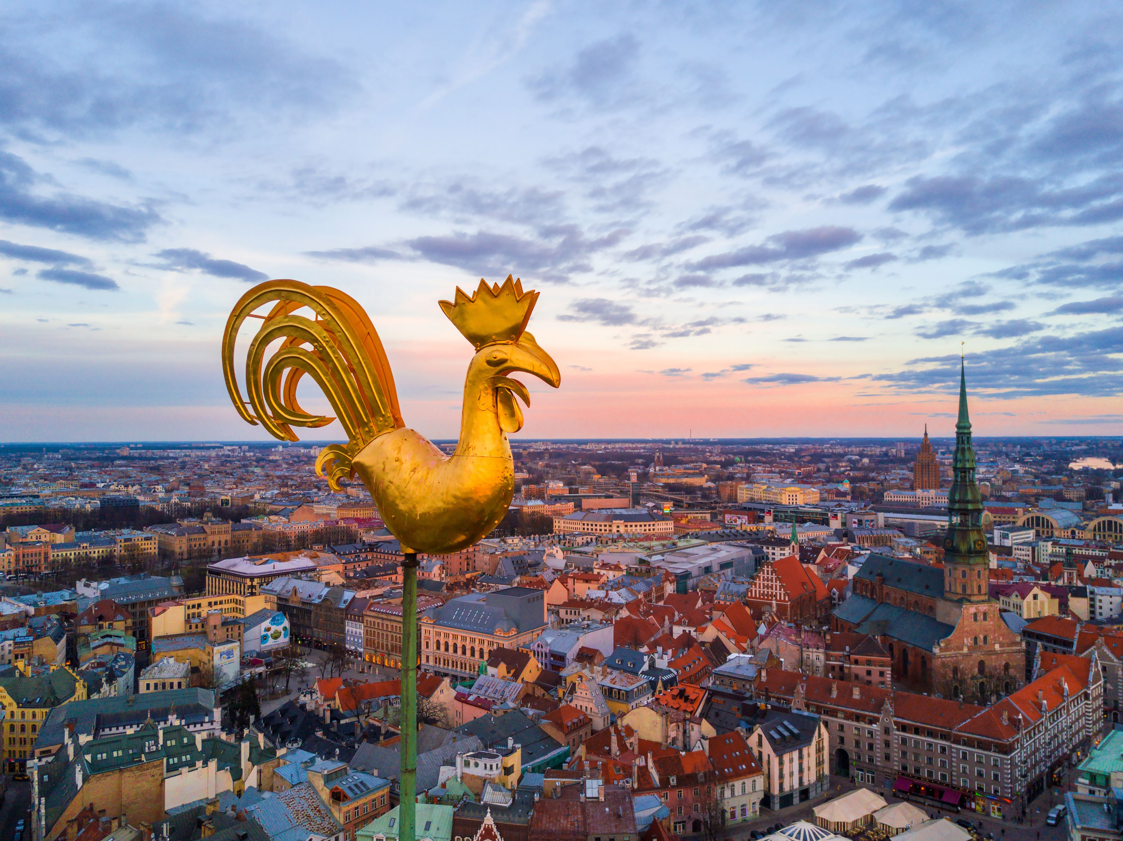
SEE YOU SOON IN RIGA!

